Slide 1

Forest FireS
Meteorological Report

Slide 2
TEAM MEMBERS
TEAM OF 4 :
Balamurali
Sunil Kumar
Amit Kumar
Nitesh

Slide 3
Forest Fire Information
ActUAL Data
StatisticAL Data.
Conclusions

Slide 4
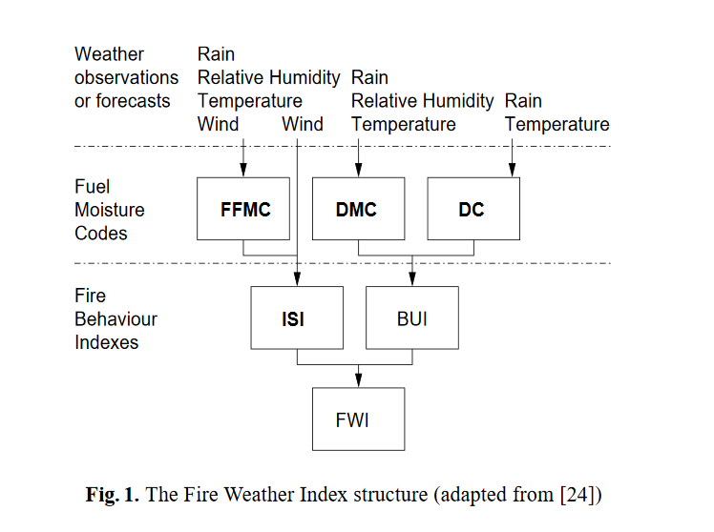
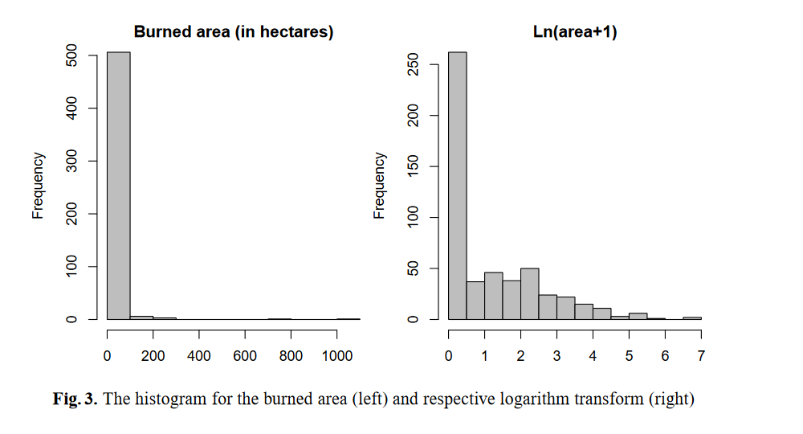
ACTUAL DATA

Slide 5
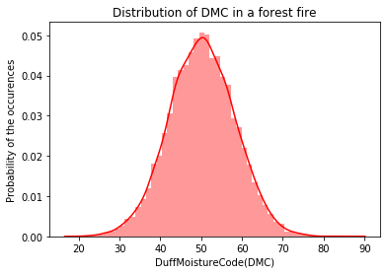
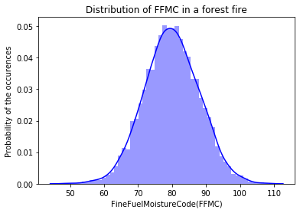
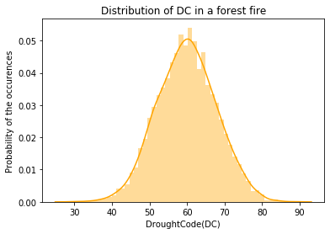
STATISTICAL DATA

Slide 6
CONCLUSION
Based on This Data we can Predict Small Forest Fires, False Alarm

